Slide 1

FROM DATA TO DELIGHT
Leveraging Airline Passenger Data to Optimize Booking Experience
Shin Eunji (2217015), Jo Seungyeon (2391028)
TEAM 5

Slide 2
BUSINESS VALUE
BUSINESS VALUE

Slide 3





BACKGROUND
The satisfaction with a ticket can vary based on numerous factors
such as the purpose of the flight, the class of the seat, the duration of the flight, and whether the aircraft is delayed.
BUSINESS VALUE
PROBLEM DEFINITION
Predicting satisfaction before purchasing airline tickets is inherently speculative and largely dependent on individual experiences. Given that airfare is typically more expensive compared to other modes of transportation, the majority of consumers find it difficult to accumulate sufficient purchasing experiences.
This lack of experience makes it challenging for them to make informed decisions about buying tickets, potentially leading to dissatisfaction and increased financial risk with their purchases.
VALUE PROPOSITION
• Reduces the time and effort customers need to spend on choosing the right airline ticket.
• Enhances convenience and overall satisfaction.
By displaying a calculated prediction of satisfaction, which considers customer information on each option within airline reservation websites, we can significantly aid customers in their ticket selection process.
• Increased customer loyalty and market profitability by providing a more personalized and efficient booking experience.

Slide 4

FORM OF INSIGHT
INSIGHT & ACTION
utilize a Binary Classification model to derive insights into customer satisfaction, categorizing responses into 0 (neutral or dissatisfaction) and 1 (satisfaction).
0: neutral or dissatisfaction
1: Satisfaction
2. The probability of being classified into class 1 is considered as the probability of satisfaction, which ranges from 0% to 100%
BUSINESS ACTION
Display the following messages on the customer's ticket comparison screen based on the calculated probability (p):
0 ≤ p < 40%
"Most customers showed dissatisfaction with this type of ticket.”
40 ≤ p < 70%
"Most customers showed neutral satisfaction with this type of ticket."
70 ≤ p < 90%
"p% of customers were satisfied with this type of ticket."
90 ≤ p ≤ 100%
"Recommended! p% of customers were very satisfied with this type of ticket."
Calculate feature importance during the Binary Classification process to identify critical factors for customer satisfaction.
Strategically target these areas for improvement.
Enhancing these critical elements allows us to not only elevate customer satisfaction but also refine our business plan to align more closely with consumer needs and preferences, ultimately driving business success.
Notes:
Insight & Action (1 slide)
1. Specific Forms of Insights
- Binary Classification(0: neutral or dissatisfaction, 1: Satisfaction) 모델을 활용
- class 1에 classify될 확률을 만족할 확률로써 고려, ranging from 0% to 100%.
2. Business Actions (to convert insights into value)
계산된 확률(p)을 바탕으로 고객의 항공권 비교 화면에 다음과 같은 문구를 출력
- 0<=p<40 : "Most customers showed dissatisfaction with this type of ticket."
- 40<=p<70 : "Most customers showed neutral satisfaction with this type of ticket."
- 70<=p<90 : "p% of customers were satisfied with this type of ticket."
- 90<=p<=100 : "Recommended! p% of customers were very satisfied with this type of ticket."
또한, Binary Classification 과정에서 활용된 features에 대해 feature importance를 계산하여 고객 만족도에 결정적인 요소를 찾아낸 뒤, 해당 요소를 개선하여 고객 만족도를 올리고 business plan에 반영할 수 있음.

Slide 5
Data Overview

Slide 6
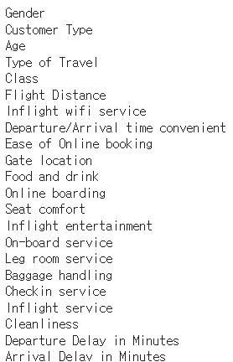
INPUT VARIABLE
Data Overview
(10394 rows, 22 columns)
OUTPUT VARIABLE
Customer's expected rate of satisfaction with this flight in calculated value.
Using ‘Satisfaction’ row
0: neutral or dissatisfaction
1: Satisfaction

Slide 7
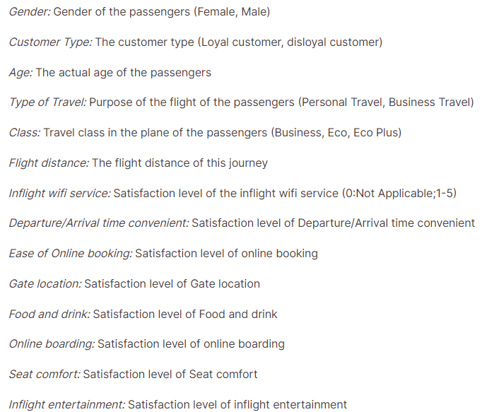
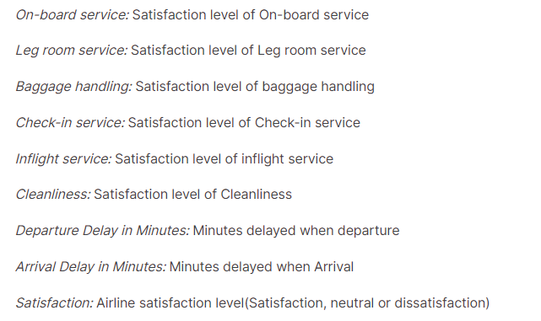
EXPLAING VARIABLES
Data Overview

Slide 8
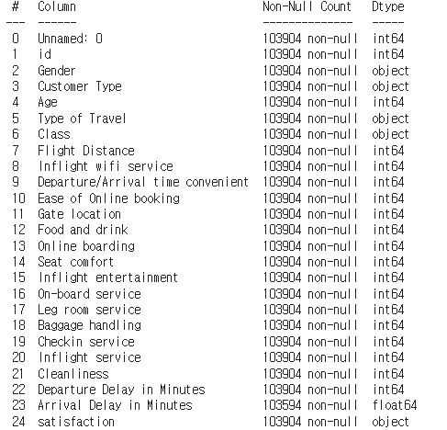























EXPLAINING VARIABLES
Data Overview
Loyal / Diloyal
Personal / Business
Business / Eco / Eco Plus
Categorical type : Gender, Customer Type, Type of Travel, Class
Numerical type : (Satisfaction rate from 1~5,
or value expressed as a number)

Slide 9
Techniques

Slide 10
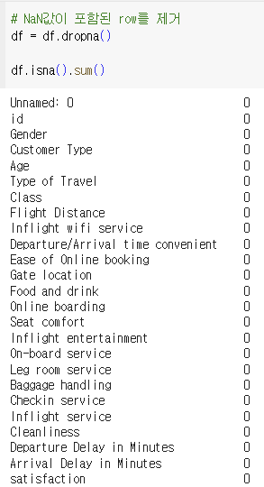
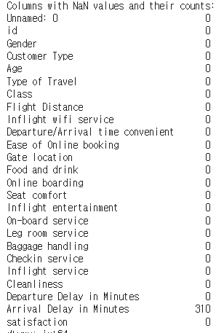
DATA PREPROCESSING
Techniques
1. Handling NaN values
There were 310 NaN values in ‘Arrival Delay in Minutes’ colmns.
So we removed rows containing NaN values.

Slide 11
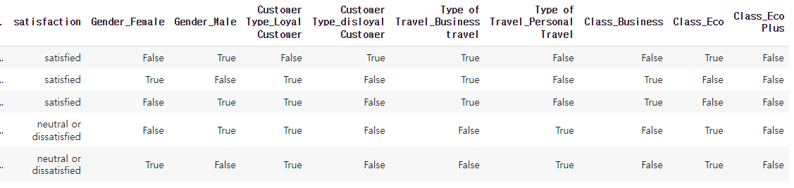
DATA PREPROCESSING
Techniques
2. Encoding
There were categorical variables ; Gender, Customer Type, Type of Travel, Class.
One-hot encoding was performed and converted so that it can be directly input into the model.
Finally, we converted the boolean type data to integer type data.
And we changed the value of the 'satisfaction' column, which is the y value we want.
The 'neutral or dissatisfied' item was changed to 0, and the 'satisfied' item was changed to 1.

Slide 12
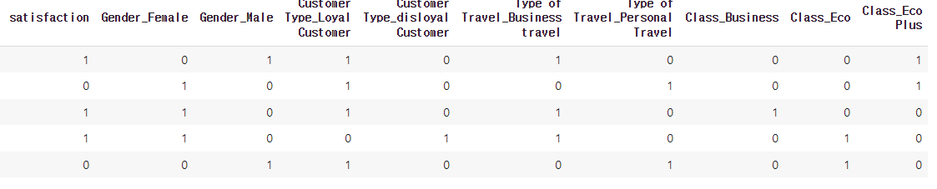
DATA PREPROCESSING
Techniques
2. Encoding

Slide 13
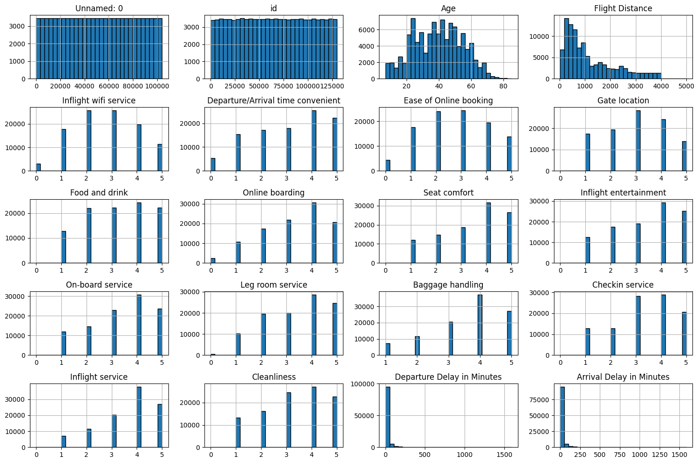
DATA PREPROCESSING
Techniques
3. Drop columns
By drawing a histogram, the 'Unnamed: 0' and 'id' columns appear without a pattern, the form of an integer that simply increases sequentially.
So we drop this 2 colums.
4. Scaling
The remaining datasets were normalized to values ​​between 0 and 1 using MinMaxScaler.
Through this process, all characteristics have the same scale, which can improve the performance of machine learning models.

Slide 14
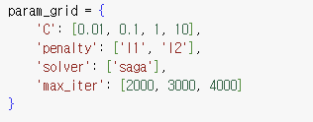
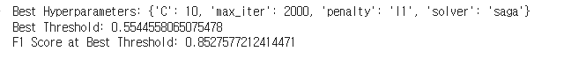
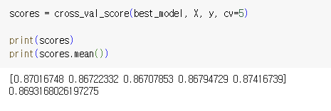
MODEL TRAINGING
Techniques
1. Model Training
To solve the binary classification problem, we used a logistic regression model.
The optimal model using logistic regression was developed using GridSearchCV. Through this, you can explore various hyperparameter combinations and find the optimal hyperparameters through cross-validation.
▲Parameter grid used
▲Result
2. Validation

Slide 15
Model Test and Result

Slide 16
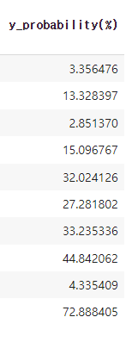
1. Data Preprocessing
Model Test & Result
We preprocessed the test set in the same way as we conditioned the train set.
2. Prediction probability Derivation → Display the following messages on the customer's ticket
0 ≤ p < 40%
"Most customers showed dissatisfaction with this type of ticket.”
40 ≤ p < 70%
"Most customers showed neutral satisfaction with this type of ticket."
70 ≤ p < 90%
"p% of customers were satisfied with this type of ticket."
90 ≤ p ≤ 100%
"Recommended! p% of customers were very satisfied with this type of ticket."
▲ Random 10 sample data
from test set result

Slide 17
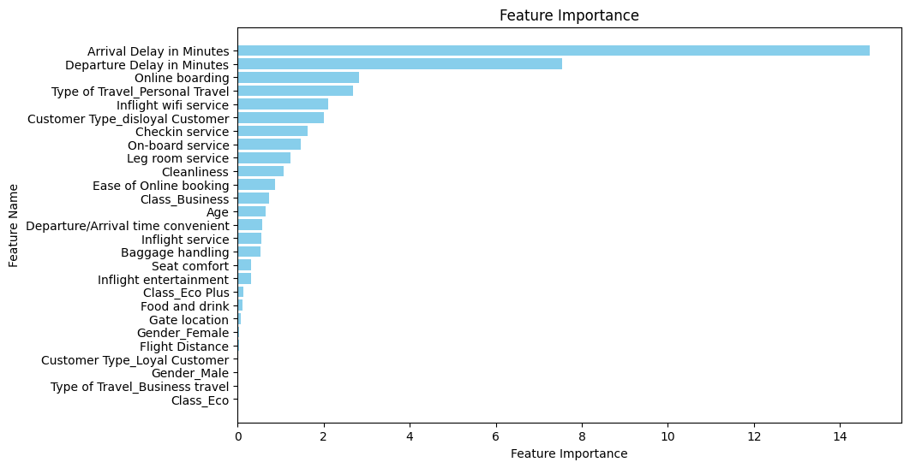
Model Test & Result
Calculate feature importance during the Binary Classification process to identify critical factors
Enhancing these critical elements allows us to not only elevate customer satisfaction but also refine our business plan to align more closely with consumer needs and preferences, ultimately driving business success.
In particular, it was found that delay time had a significant impact on customer satisfaction compared to other factors such as service and pre-flight experience.

Slide 18
Model Test and Result
Thank you

